Slide 1
Software Quality Engineering
Lecture 3
Part II-software testing
Functional testing
alina.arshad@nu.edu.pk

Slide 2
Use cases testing
Use Case Testing is a functional black box testing technique that helps testers to identify test scenarios that exercise the whole system on each transaction basis from start to finish.
Use cases are a representation of the expected behavior of a system as it should respond to the requests of users external to the system.
The level of modeling detail can vary for use cases, which usually involves transactions from initiation until termination, and includes other factors besides the system, such as sub-systems or other software applications.
The sum of all the use cases is used to describe the way the system or software works.
This is the case in agile development methods when specifications are provided in the form of use cases or user stories.

Slide 3
Cash withdrawal – use case specification
Brief Description
This use case describes how the Bank Customer uses the ATM to withdraw money to his/her bank account.

Slide 4
4 Basic Flow of Events
1. The use case begins when Bank Customer inserts their Bank Card.
2. Use Case: Validate User is performed.
3. The ATM displays the different alternatives that are available on this unit. In this case the Bank Customer always selects "Withdraw Cash".
4. The ATM prompts for an account.
5. The Bank Customer selects an account.
6. The ATM prompts for an amount.
7. The Bank Customer enters an amount.
8. Card ID, PIN, amount and account is sent to Bank as a transaction. The Bank Consortium replies with a go/no go reply telling if the transaction is ok.
9. Then money is dispensed.
10. The Bank Card is returned.
11. The receipt is printed.
12. The use case ends successfully.

Slide 5
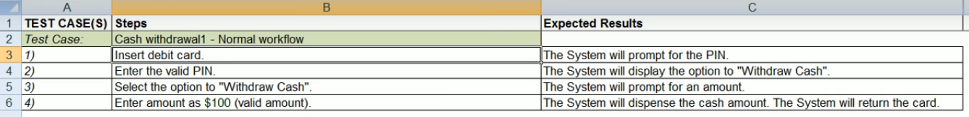
Test cases

Slide 6
Test cases

Slide 7
Test cases

Slide 8
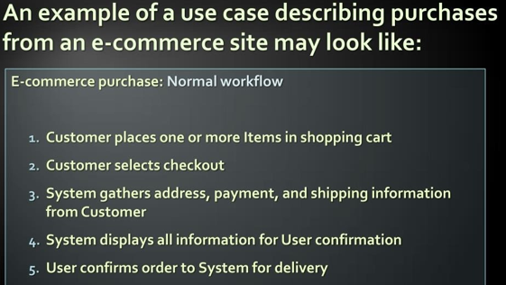

Slide 9
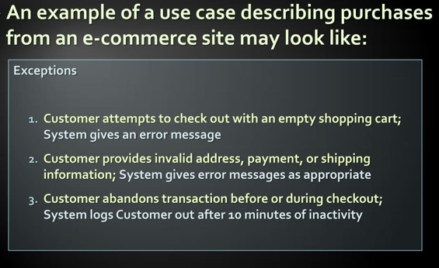
E-commerce use case 2

Slide 10
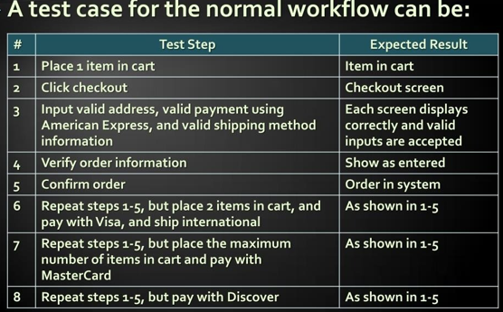

Slide 11
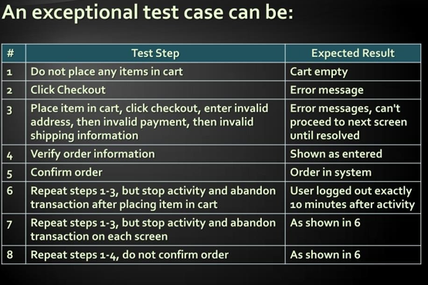

Slide 12
Any question????

